Slide 1

B.Tech.-CSE, VIII Semester Project Title – Analysis of Effects of Physical and E-Games on Human’s cognitive and Physical behavior. Project No. – 110
Presented by :-
Name- UJJAWAL TIWARI
Sys. ID-2019620347
Name- Gautam Suri
Sys. ID-2019628143
Under the Supervision of:-
DR. RAJENDRA KUMAR
DEPARTMENT OF COMPUTER SCIENCE & ENGINEERING
SCHOOL OF ENGINEERING AND TECHNOLOGY
August, 2022

Slide 2
OUTLINES
INTRODUCTION
LITERATURE REVIEW
WORK APPROACH
METHODOLOGY
RESULTS and DISCUSSIONS
CONCLUSIONS
REFERENCES

Slide 3
INTRODUCTION
This study focuses on the development of the individuals who are big players of the E-gaming world.
This is a study which extracts the data and further a comparative analysis is held between the two types of gaming which leads us to provide suggestive measures for the minimal harm.
As each day passes there are a large number of victims that are getting indulged in e-games and some in physical games that the injuries they have had. That is a spark in the kick-start of this research that both the games have pros and cons and what they lead to in the life of a human being.

Slide 4
LITERATURE REVIEW
There have been several studies that determine the positive’s and negative’s of E-games and physical games
To the best of our knowledge, NO research has been found which shows detailed comparative analysis between both the industries.
A research by Department of Human Kinetics and Health Education, University of Ibadan, Ibadan Nigeria[1] found that children playing video games for a long time were found with Musculoskeletal problems, Obesity, vision issues, Seizures (Epileptic).
A different study was done on male and female by School of Education, University of Isfahan, Isfahan, Iran[2] showcased addiction to computer games affects various dimensions of health and increases physical problems, anxiety and depression, while decreases social functioning disorder.
An article in Indianexpress[3] stated that teenagers may be inclined to sacrifice their studies to ambition for athletic distinction. they put lots of physical strain on their body. This causes harm to their physical and mental fitness.

Slide 5
LITERATURE REVIEW
A contradictory study done by a Professor of Gambling Studies in the Psychology Division, Nottingham Trent University[4] stated that video games for educational purpose were proved to be BENEFICIAL as they can assist children in setting goals, ensuring goal rehearsal, providing feedback, reinforcement, and maintaining records of behavioral change moreover Videogames attract participation by individuals across many demographic boundaries.
A study done by Termez State University Lecturer, Faculty of Sports Activity and Management[5] concluded with OUTDOOR GAMES should be used as an educational and recreational means of socialization of the individual. They are able to intensify the EDUCATIONAL process, provide a motivational basis for the formation of physical and spiritual properties and personal self-regulation of school children.

Slide 6
METHODOLOGY
The methodology of research consists of three stages:
(I).data collection;
(ii).data analysis;
(iii).data visualization

Slide 7

DATA COLLECTIONS and it’s analysis
mapping to check the dependency between values of the attributes to apply the research to predict and correlate data series. We consider a dependent variable y to correlate with independent variables x₁, x₂, ..., x_{k} as:
where e = (0, σ²) . Here, “σ” (sigma) is called population variance. It is used because this entire working is based on the population prospect
Using SAMPLING, the data can be obtained in n groups of observation as
where x_{ij} is the j^{th} are the observed values of the independent variable x_{i}, while y_{j} is the j^{th} observed value of the dependent variable y.

Slide 8
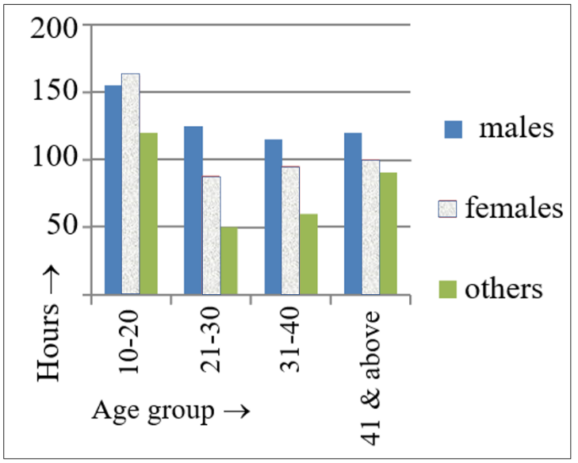
ANALYSIS and RESULTS
The dataset has the data of 13465 gamers.
50 General descriptive statistics (e.g., Gender, time spent, age, Platform being used to play, etc.) and more sophisticated questions like the purpose. Solo players or it’s a competition.
By finding the average, we get the following result:
Males – 140 hours ; Females – 120 hours ; Others – 95 hours
Fig.1: Gender specification with age groups spending time on E-gaming

Slide 9
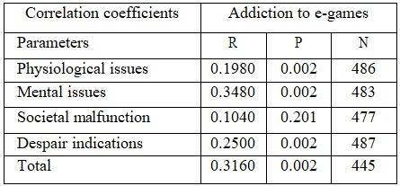
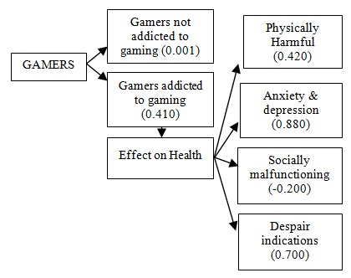
RESULTS and DISCUSSIONS
The letters R, P, and N denote:
R (Retest) version, which is used to assess changes in mental health over time by administering the questionnaire twice to the same individual, overall level of mental distress.
P (Profile) version, which is used to assess a person's current situation in all forms.
N (Non-patient) version, which is used to assess the mental health of people who are not currently receiving mental health treatment.
T1: Medical problems in different cases T2: Flowchart of problems happening due to
various reasons

Slide 10
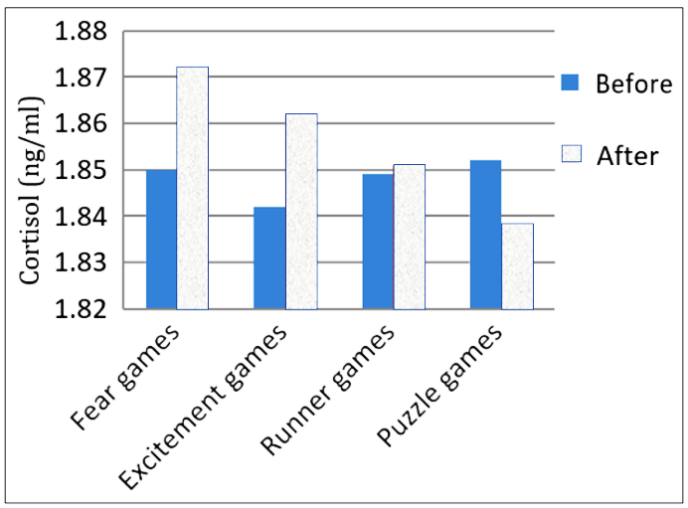
RESULTS and DISCUSSIONS
Cortisol HORMONE’S level is denoted in the measurement unit ng/ml which stands for nanograms per millilitre which depicts test results in urine and oral fluid as cortisol is measured by SOME MEDICAL tests.
Fig.5: Shows fluctuations in the salivary cortisol levels
when playing different games.

Slide 11
CONCLUSIONS
There was a direct relationship between addiction to computer games and physical disorder, anxiety, sleep disorder and depression. But, the relationship between addiction to computer games and social dysfunction is reverse.
5% variance of addiction to computer games is common with physical disorder, 19% with anxiety and sleep disorder, 2% with disorder of social functioning and 10% with depression.
We can see that the age group of 21-30 plays the games most out of all the groups.
CORTISOL is getting affected by different types of gaming.
The correlation parameters of mental issues, societal malfunction, despair indications, health and addiction to e-games are observed as positive.
The highest fluctuation in the salivary cortisol level is observed when playing fear e-games and the lowest fluctuation is in the case of puzzle games.

Slide 12
REFERENCES
1). Israel,O. N., Gaming disorder andeffectsofgamingonhealth,JournalofAddictionMedicine and Therapeutic science,doi:10.17352/2455.38884.000025, 4(1), pp. 1-3,2018.
2). Kracht C. L., Joseph, E. D., Staiano, A. E. Video Games,Obesity, and Children, current obesity reports, doi:10.1007/s13679-020-00368-z,pp.1-14,2020.
3). ZamaniE,chashmiM,hedayatiN.EffectofAddiction to Computer Games on Physical and MentalHealthofFemaleandMaleStudentsofGuidance School in City of Isfahan, Addiction and Health, 1(2), pp. 98-104, 2009.
4).Goldberg,D. P.,Hillier,V. F.,AScaledVersionoftheGeneralHealthQuestionnaire,PsychologicalMedicine,doi:10.1017/s0033291700021644, pp.139-145, 1979.
5). APNewsAgency,CompulsiveVideo-gamePlayingnowQualifiesasaMentalHealthProblem,2018,
6). GranicI.,LobelA.,Engels,R.C.,Thebenefitsofplayingvideogames,American Psychologist,doi:10.1037/a0034857,pp.66-78,2014.
7).AbdullaevYashnarzhonMakhkamovich.PhysicalEducation of Senior Schools by Means of Folk MovingGames, European Scholar Journal, 2(11),pp.70-72, 2021.
8). https://www.kaggle.com/datasets/divyansh22/online-gaming-anxiety-data
9). Steffen, C. E., Schmidt, Jens-Peter Gnam, MaximilianKopf,Tobias,R.,Alexander,W.TheInfluenceofCortisol,Flow,andAnxietyonPerformanceinESports:AFieldStudy,BioMedResearch International, doi: 10.1155/2020/9651245,pp.3-6, 2020.
10). Aliyari, H., Sahraei, H., Daliri, M. R., Minaei-Bidgoli, B., Kazemi, M., Agaei, H., Sahraei, M., Hosseini, S. M. A. S., Hadipour, M. M., Mohammadi, M., Dehghanimohammadabadi, Z. The Beneficial or Harmful Effects of Computer Game Stress on Cognitive Functions of Players. Basic Clin Neurosci. 9(3), pp. 177-186, 2018. doi:
11). Kumar, R., Human Computer Interaction, Firewall Media, 2011.Steffen, C. E., Schmidt, Jens-Peter Gnam, MaximilianKopf,Tobias,R.,Alexander,W.TheInfluence ofCortisol,Flow,andAnxietyonPerformanceinE Sports:AFieldStudy,BioMedResearch International, doi: 10.1155/2020/9651245,pp.3-6, 2020.

Slide 13
THANK YOU FOR YOUR ATTENTION AND REVIEW! PLEASE TAKE CARE.

